Slide 1
CPS 235 Object Oriented Programming Paradigm
Lecturer Rabia Khan
Classes (Part II)
CPS235:Classes

Slide 2
Contents
Access modifiers
static class data and member functions
const member functions and objects
Destructors
References
Copy Constructor
CPS235:Classes

Slide 3
Class Members
A class can have three kinds of members:
  fields: data variables which determine the status of the class or an object
  methods: executable code of the class built from statements. It allows us to manipulate/change the status of an object or access the value of the data member
  nested classes and nested interfaces
Notes:
the interfaces are classes that cannot have method implementations and variables. They may only have function prototypes.

Slide 4
Fields
Field Declaration
  a type name followed by the field name
  primitive data type vs. Object reference
    boolean, char, byte, short, int, long, float, double
  field declarations can be preceded by different modifiers
    access control modifiers (public, private, package, protected)
    static
    final

Slide 5
Field Modifiers
Access control modifiers
  private: private members are accessible only in the class itself. If not specified, the access is set to private.
  protected: protected members are accessible in classes in the same package, in subclasses of the class, and in the class itself
  public: public members are accessible anywhere the class is accessible

Slide 6
Static Class Data
Each object created has its own separate data. But all objects in a class use the same member functions since the functions for each object are identical
The member functions are created and placed in memory only once where they are defined
However if a data item in a class is declared as static, then only one such item is created for the entire class no matter how many objects are created
The static variable’s declaration appears inside the class declaration but the variable is actually defined outside the class.
Each object does not have a separate copy of static data member rather its more of a global variable
CPS235:Classes

Slide 7
Static Class Data
class foo
{
private:
static int count; //declaration only
public:
foo()
{ count++; }
int getCount()
{ return count; }
};
int foo::count = 0;//definition outside the class
int main()
{
foo f1,f2,f3;
cout<<f1.getCount()<<f2.getCount()<<f3.getCount();return 0;
}
CPS235:Classes

Slide 8
class CRectangle
{
int x, y;
public:
static int index; //declaration only
void set_values (int,int);
int area ()
{return (x*y);}
};
void CRectangle::set_values (int a, int b)
{ x = a; y = b; }
int CRectangle::index = 0; //definition outside the class
int main ()
{ CRectangle rect1, rect2; //creating 2 objects
rect1.set_values (3,4);
rect2.set_values (6,5);
rect1.index++;
cout<<rect1.index; //Result? 1
rect2.index++;
cout<<rect2.index; //Result? 2
Crectangle::index++;
cout<<rect1.index; //Result? 3
cout<<rect2.index; //Result? 3
return 0;
}
Notes:
Please note that a static variable can be accessed using a class name and a scope resolution operator. This is a preferred method of accessing static member variables

Slide 9
Static Member Functions
Defined using the keyword static
Function call is made with the scope resolution operator thus associating the function to the class rather than to a particular object
Nonstatic member functions can access the static variables (int getCount() ) in the previous example
However, a static member function cannot access nonstatic data
CPS235:Classes
Notes:
The static member functions are not used very frequently in programs. But nevertheless, they become useful whenever we need to have functions which are accessible even when the class is not instantiated.
A static member function can access only static member data, static member functions and data and functions outside the class.

Slide 10
Static Member Functions
class foo
{
private:
static int count; //declaration only
public:
foo()
{ count++; }
static int getTotalCount() //a static function
{ return count; }
};
int foo::count = 0; //definition outside the class
int main()
{
foo f1,f2,f3;
cout<<“Total Count:”<<foo::getTotalCount()<<endl;
return 0;
}
CPS235:Classes

Slide 11
const member functions
A const member function ensures that it will not modify any of the class member data
The const keyword should be used in both the declaration (if any) and the definition of the function body
Member functions that do nothing but acquire data from an object (for instance the display or show functions) are candidates for being made const
void showdist ( ) const
{
cout <<feet << “ \‘ –” << inches <<“\” “;
}
CPS235:Classes

Slide 12
const member functions
class aClass
{
private:
int a;
public:
void nonConst_Func ( ) //non const function
{ a = 100;}
void const_Func ( ) const //const function
{ a = 100;} // Error :can’t modify a member
};
CPS235:Classes

Slide 13
const member function arguments
If an argument is passed to a function by reference, and you do not want the function to modify it, the argument should be made const in the function declaration and definition
Distance add_dist(const Distance& d2) const
{
Distance temp;
//d2.feet=0; //ERROR: can’t modify d2
//feet =0; //ERROR: can’t modify this. Why??
temp.inches = inches + d2.inches;
if (temp.inches >= 12.0)
{ temp.inches -= 12.0;
temp.feet=1;
}
temp.feet += feet + d2.feet;
return temp;
}
CPS235:Classes

Slide 14
Common Programming Errors
Defining as const a member function that modifies a data member of an object is a compilation error
Defining as const a member function that calls a non-const member function of the class on the same instance of the class gives a warning message
Invoking a non-const member function on a const object gives a warning message
CPS235:Classes

Slide 15
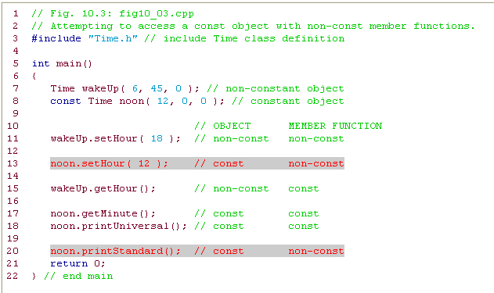
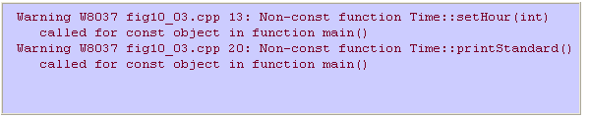
Using const
CPS235:Classes

Slide 16
What will be the output?
class Something
{
private:
static int a;
int ID;
public:
Something() { ID = a++; }
int GetID() const { return ID; }
};
int Something::a = 1;
int main() {
Something cFirst;
Something cSecond;
Something cThird;
cout << cFirst.GetID() << endl;
cout << cSecond.GetID() << endl;
cout << cThird.GetID() << endl;
return 0;
}
CPS235:Classes

Slide 17
const Objects
In several example programs we’ve seen that we can apply const to variables of basic types like int to keep them from being modified.
In a similar way we can apply const to objects of classes. When an object is declared as const, you can’t modify it. It follows that you can use only const member functions with it, because they’re the only ones that guarantee not to modify it.
CPS235:Classes

Slide 18
class Distance
{
private:
int feet;
float inches;
public: //2–arg constructor
Distance(int ft, float in) : feet(ft), inches(in) { }
void getdist() //user input; non–const func
{
cout << “\nEnter feet: ”; cin >> feet;
cout << “Enter inches: ”; cin >> inches;
}
void showdist() const //display distance; const func
{ cout << feet << “\’–” << inches << ‘\”’; }
};
////////////////////////////////////////////////////////////////
int main()
{
const Distance football(300, 0);
// football.getdist(); //ERROR: getdist() not const
cout << “football = ”;
football.showdist(); //OK. Const membe function used
cout << endl;
return 0;
}
CPS235:Classes

Slide 19
Class Destructors
Destructors are usually used to deallocate memory and do other cleanup for a class object and its class members when the object is destroyed
Same name as the class but preceded by a tilde (~)
Has no arguments and no return type
A class may have only one destructor. Destructor overloading is not allowed
class X {
private:
int x;
public:
X():x(0){} // Constructor for class X
~X(){} // Destructor for class X
};
CPS235:Classes

Slide 20
References

Slide 21
What is a Reference?
A reference is an alias
When you create a reference, you initialize it with the name of another variable/object, the target
Then the reference acts as an alternative name for the target
  Any changes made to the reference are actually being performed on the target
References CANNOT be reassigned
CPS235:Classes

Slide 22
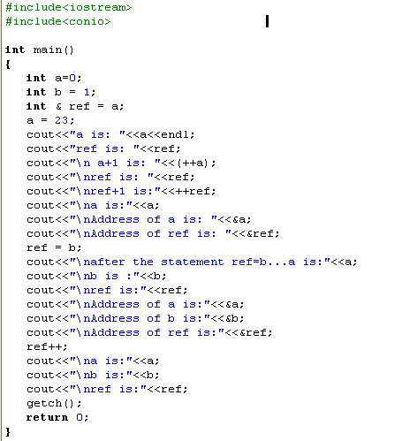
CPS235:Classes

Slide 23

CPS235:Classes

Slide 24
Using References
ref is an alias to a
ref does not hold its own int value
It is just another way to get at the int value stored in a
Syntax
Data Type of value to which reference will refer
Reference operator (&)
Alias i.e., the name of the reference
Equal to (=)
Variable to which the reference will refer i.e., the name of the target object

Slide 25
Important while using References
Because a reference must always reference to another value, you must initialize a reference when you create it
If you don’t, you will get a compiler error
int & ref ; //ILLEGAL
A reference always refers to value with which you initialized it
You cannot reinitialize a reference to another value
References to Objects of a Class can be created in the same way
  Distance dist1(10,5.5);
  Distance & ref_dist = dist1;

Slide 26
Why pass by reference?
Reference variables if used as in slide 22 does not show much of a utility but references come into shine when it comes to functions.
Passing by reference is efficient because you don’t make a copy of the argument variable
  You provide access to original variable through a reference
  The function will modify the actual data which has been passed by reference
Moreover, sometimes more than one value ought to be returned from a function. This is where using references can be useful.

Slide 27
#include <iostream.h>
void times2(int &v1, int &v2); // function prototype
void main()
{
int x,y;
x = 10;
y = 15;
cout << "x is " << x << " and y is " << y << endl;
times2(x,y);
cout << "x is now " << x << " and y is now " << y << endl;
}
void times2(int &v1, int &v2)
{
v1 = v1 * 2;
v2 = v2 * 2;
}

Slide 28
Why pass by reference in objects?
Since objects can be very large, unnecessary copies waste memory space
  Creating a copy of an object is not as straightforward as creating a copy of a variable of basic data type
  The default copy constructor is implicitly called by the compiler when an object is passed by value

Slide 29
Copy Constructor
When is it used?
Programmer can use copy constructor explicitly to create an object that is a copy of an existing object
Compiler generates a call to copy constructor, when object is passed as a value parameter
By default, the compiler generates a copy constructor for each class
  This default copy constructor makes a copy of an object member by member
CPS235:Classes

Slide 30
When is a Copy Constructor called?
You pass a copy of an object as argument to a function (i.e. when passing by value).
  func(dist1)
When you return an object from a function
  return dist1;
Or initialize an object during declaration using another object.
  Employee e1=e2;
  Employee e1(e2);
CPS235:Classes

Slide 31
The Default Copy Constructor
void main()
{
  Distance dist1(10,5.5);
  Distance dist2(dist1);//causes the default copy constructor to perform a member-by-member copy of dist1 into dist2
  Distance dist3 = dist1;//has the same effect as the above statement
}
CPS235:Classes

Slide 32
Making your own copy constructor
#include<iostream>
#include<conio>
class foo
{
private:
static int count;
int id;
public:
foo():id(0) // no arg constructor
{ count++; }
foo(int i):id(i) //1-Arg constructor
{ count++; }
static int getTotalCount()
{ return count; }
void display()
{ cout<<"object id:"<<id; }
foo(const foo&);// copy constructor
};
CPS235:Classes

Slide 33
Making your own copy constructor
int foo::count = 0 // initializing a static data member
foo::foo(const foo& f):id(f.id)
{
count++;
}
int main()
{
foo f1;
foo f2(1);
foo f3(2);
foo f4(f3); //will not change count to 4 if default copy constructor is called
f1.display();
f2.display();
f3.display();
f4.display();
cout<<"Total Count:"<<foo::getTotalCount()<<endl;
getch();
return 0;
}
If you do not make your own copy constructor in this case, then the count variable will not be updated if the default copy constructor is called
CPS235:Classes

Slide 34
Making your own copy constructor
A 0ne-argument constructor which has the same name as the class and no return type
The argument is always an object of the same class
The argument must be passed by reference
  If it is passed by value, then automatically the copy constructor is called to create a copy which means the constructor will call itself to make a copy and this process runs an infinite number of times
The argument should be constant
  An important safety feature since you do not want to modify the data of the object being passed to the constructor
CPS235:Classes

Slide 35
Compulsory Reading
Robert Lafore, Chapter 6: Objects and Classes
Robert Lafore, Chapter 4, Topic: Enumerations
CPS235:Classes

